Slide 1
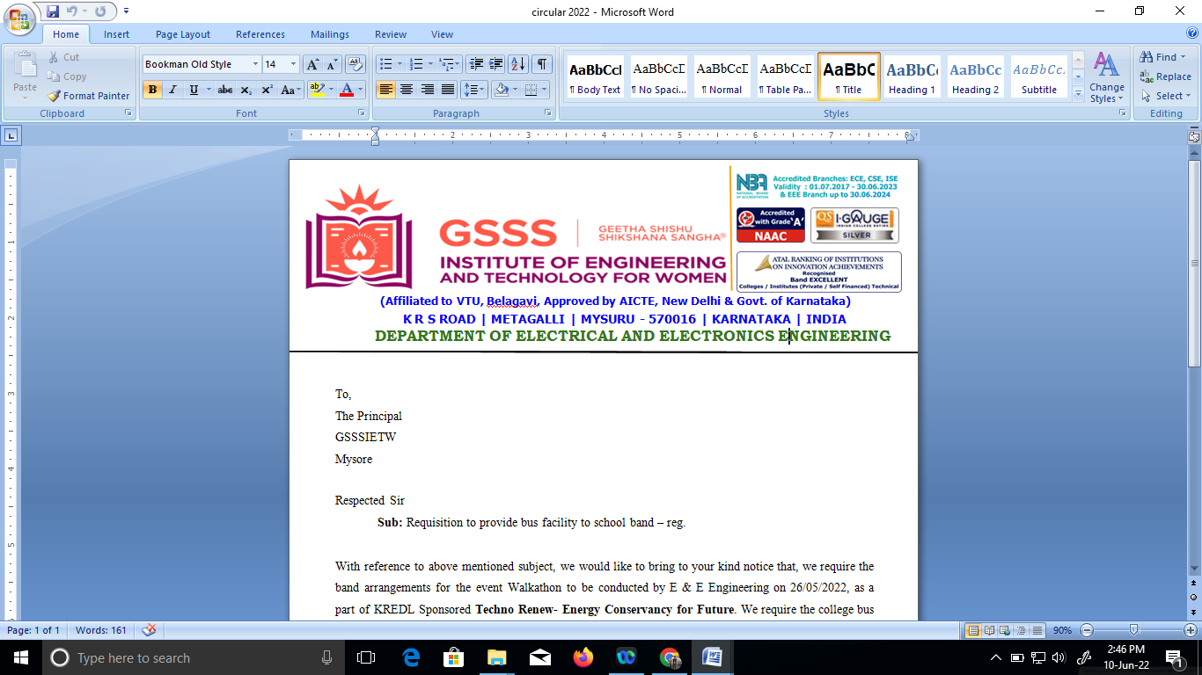

PESTICIDE SPRINKLER WITH IOT BASED SECURITY
by
Bhoomika C P 4GW19EE005
Prakruthi K N 4GW19EE026
Rakshitha G 4GW19EE030
Vidyashree K 4GW19EE041
Under the Guidance of
Smt. SHILPASHRI V N
Assistant Professor
Dept. of EEE, GSSSIETW, Mysuru
Department of Electrical & Electronics Engineering
Project Phase -I (18EEP78)
Progress - II
PRESENTATION ON

Slide 2
Overview
Correction suggested during phase 1
Correction incorporated
Progress
Introduction
Literature survey
Scope of project
Objectives
Methodology
Hardware & Software Description
Expected Outcome
References

Slide 3
Correction Suggested During Phase-1
To specify the spraying angle.
Motor specifications.
Type of bluetooth used.

Slide 4
Correction Incorporated
The spraying angle is 180 degree.
Motor specification (30 RPM, 5V)
Bluetooth module : (HC-05)

Slide 5
Progress
Read various articles on ill-effects of pesticides on humans.
Currently working on programming using Arduino IDE software.
Purchased Hardware components : Arduino UNO, Intruder sensor, Battery, Bluetooth module, DC motor.
Pumping system is ready.
Intruder system is under development.

Slide 6
Methodology of pump system :-We use Arduino/Node mcu board to control pump that sprays pesticides we To control the flow of pump we use relay Or without relay also we can implement it. By connection it to battery (9V )
The relay is the intermediate component between the Arduino board and the water pump. It allows the Arduino board to control the water pump. The role of the relay is to start or stop the pump responsible for filling the bottles.
We connect the (-) terminal of the relay to the GND pin of the Arduino
We connect the (+) terminal of the relay to the 3.3V pin of the Arduino
We connect the terminal (S) of the relay to pin N° 2 of the Arduino the role of the push button is the activation or deactivation of the relay module.
We connect the first terminal of the button to the GND pin of the Arduino.
We connect the second terminal of the button to pin N°1 of the Arduino.

Slide 7
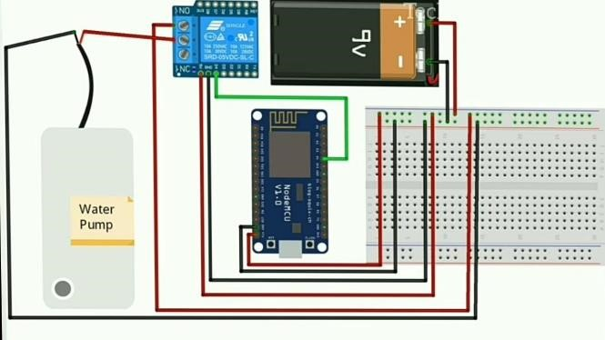
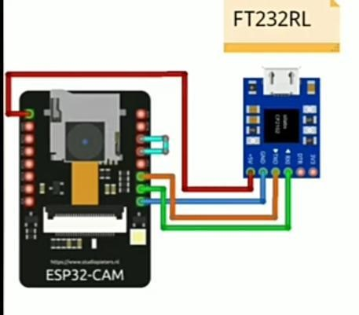
Methodology of intruder system :- we use Arduino UNO we connect camera or pir sensor to check the area around it. Pir sensor used to check the motion
Camera used to capture the image.

Slide 8
Source code
#define BLYNK_TEMPLATE_ID "TemplateID“
#define BLYNK_DEVICE_NAME "Control Pump“
#define BLYNK_AUTH_TOKEN "Auth Token“
#define BLYNK_PRINT Serial
#include <ESP8266WiFi.h>
#include <BlynkSimpleEsp8266.h>
char auth[] = BLYNK_AUTH_TOKEN;
char ssid[] = "Wifi Username"; // Enter your wifi name
char pass[] = "Wifi Password"; // Enter your wifi password
int relaypin = D4;
void setup()
{
Serial.begin(115200);
Blynk.begin(auth, ssid, pass);
pinMode(relaypin,OUTPUT);
}
void loop()
{ Blynk.run();
}

Slide 9
Introduction
India is the farmland with a population of 3/4 in agriculture. In accordance with the climate and other resources accessible to them, farmers will grow multiple plants in their field.
Some technological assistance are required to achieve high output and excellent quality. The increase in the demand of labour in the agriculture fields is increasing day by day as the people now a days are less interested in agriculture so all we need is a robot which can replace humans.
Pesticide spraying plays a key role in protecting the field. Many people are not interested in spraying pesticides as they are getting harmful skin infections and breathing problems also carbon dioxide emitted as pollutant during the operation of such pumps has a harmful effect in the environment.
Another important factor is human error which leads to unexpected issues while spraying. For instance, Due to lack of awareness human labour may spray extra dosage to the plants that leads severe damage to the field.

Slide 10
Literature Review
Peng Jian-Sheng - “Robot System for Spraying Pesticides”. This paper gives an outline of the present status of pesticides in horticultural creation is a bug spray, sanitization, bug or weed killing. Various statures crops by showering activity tests show that a specific defensive, commonsense, versatile robot, better splash impact at the right workplace, such Its minimal expense, simplicity of taking care of and simple support and different qualities of people with a wide market in farming creation.
Mitul Raval, Aniket Dhandhukia, Supath Mohile - “Development Automation of Robot with Spraying Mechanism for Agricultural Application”. Pesticide showering instrument with the assistance of current advanced mechanics innovation is the fundamental reason for this task which would help the rancher in his everyday splashing movement. This paper means to audit the current turn of events and the future extent of this Technology.

Slide 11
Lokare Mahesh Sanjay, Shinde suryakant popat - “Wireless robot system for spraying pesticides”. This paper presents the advancement cycle of splashing pesticides, executed utilizing a PIC16F877 a microcontroller.
Amruta Sulakhe, M.N. Karanjkar - “Design and Operation of Agriculture Based Pesticide Spraying Robot”. The investigation showed that the robot can fundamentally finish crafted by programmed control and meet splashing prerequisites in the nursery. The control framework has great strength and dependability.

Slide 12
Scope of Project
It is used for controlling pests. Pesticides are mixed with water and then sprayed to areas infested.
It is also used for spraying livestock to kill ticks and other dangerous pests that lower production.
It is used for applying liquid substances such as fertilizers and pesticides to plants during the crop growth cycle.
The main scope of spraying robot is to deliver an effective, uniform dose of product to a target area in a safe and timely manner.

Slide 13
Objectives
To spray pesticides with more efficiency, low cost and also with less human power.
To speed up the pesticides spraying operation.
To apply the correct rate of the recommended product uniformly to the target without contaminating non-target areas.

Slide 14
Methodology
The first step to design the Agri-robots is to conduct the field survey to know the requirements, which helps to decide upto what level we have to design and automate the robot.
The two important parts in Agri-robots specially the pest controlling robot are the chassis i.e., mechanical frame design and electronics that is sensors, processor, different controlling module, etc. From field survey we can design the chassis according to the pattern of Agri-land.
IT also helps to decide what components and materials we should consider, how we can automate the motion of robot, of what power electric motors we should use, etc.

Slide 15
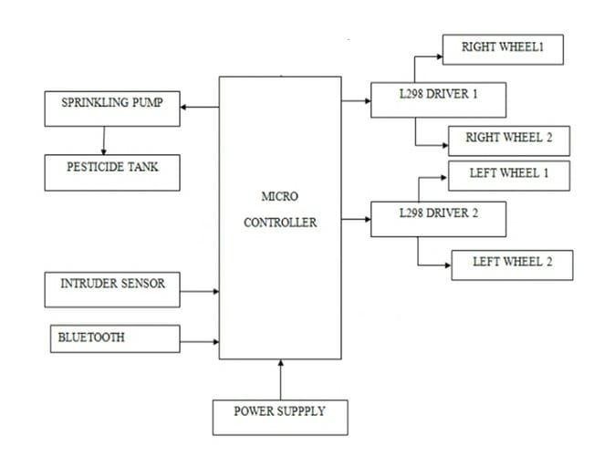
Block Diagram

Slide 16
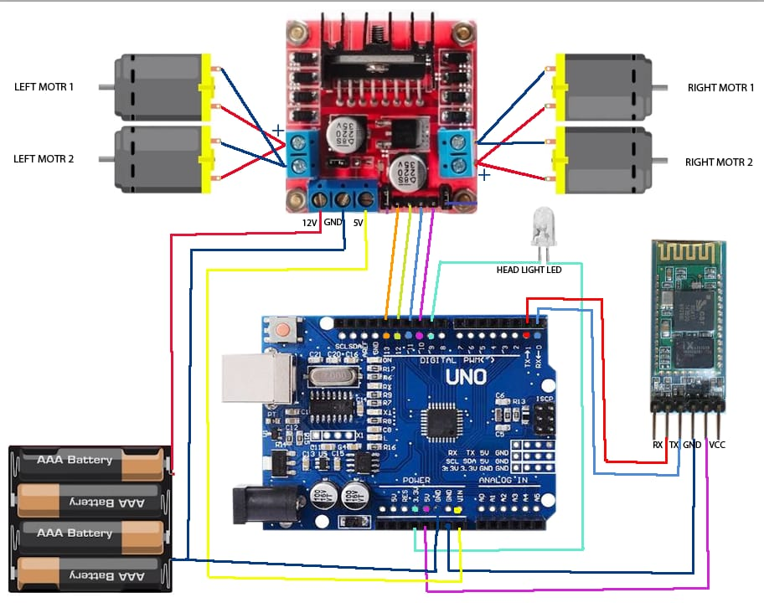

Slide 17
Hardware & Software Description
HARDWARE COMPONENTS
Arduino uno - Arduino Uno is a microcontroller board based on the ATmega328P. It has 14 digital input/output pins, 6 analog inputs, a 16 MHz quartz crystal, a USB connection, a power jack, an ICSP header and a reset button. It contains everything needed to support the microcontroller; simply connect it to a computer with a USB cable or power it with an AC-to-DC adapter or battery to get started.
Pesticide Sprinkler - Sprayers convert a pesticide formulation, which can be large rain-type drops or tiny almost-invisible particles.
Pesticide Tank - The container that contains the mixture of water or another liquid chemical carrier, such as fertilizer and chemical which has to be applied on the crops.
Intruder sensor - Intrusion sensors are meant to determine whether an unauthorized person has accessed, or attempted to access, a protected area.

Slide 18
DC Motors(30 RPM-5volts) - A DC motor is any of a class of rotary electrical motors that converts direct current (DC) electrical energy into mechanical energy. The most common types rely on the forces produced by magnetic fields.
Bluetooth module (HC-05) - A standard for the short-range wireless interconnection of mobile phones, computers, and other electronic devices.
Battery - A lithium-ion or Li-ion battery is a type of rechargeable battery which uses the reversible reduction of lithium ions to store energy. It is the predominant battery type used in portable consumer electronics and electric vehicles. Compared to other rechargeable battery technologies, Li-ion batteries have high energy densities, low self-discharge, and no memory effects.
Microcontroller - A microcontroller (MCU for microcontroller unit) is a small computer on a single VLSI integrated circuit (IC) chip.

Slide 19

SOFTWARE COMPONENTS
Arduino IDE - An integrated development environment (IDE) is a software application that provides comprehensive facilities to computer programmers for software development. An IDE normally consists of a source code editor, build automation tools and a debugger.

Slide 20
EXPECTED OUTCOME
The spraying time of insecticides is depending on the quantity of pesticide to be sprayed.
Internet of Things is far and wide castoff in relating devices and gathering statistics. This agriculture monitoring system serves as a reliable and efficient system and corrective action can be taken. Wireless monitoring of field reduces the human power.

Slide 21
REFERENCE
Peng Jian-sheng., “An Intelligent Robot System for Spraying Pesticides”, The Open Electrical & Electronic Engineering Journal, 2014, 8, 435-444.
Shedbaletamannarafique, Lokare Mahesh Sanjay, Bhosaleajay Sunil, Shinde Suryakant Popat., “Wireless robot system for spraying pesticides ”, 2017 IJRTI , Volume 2, Issue 3 ISSN: 2456-3315
Mitul Raval, Aniket Dhandhukia, Supath Mohile., “Development and Automation of Robot with Spraying Mechanism for Agricultural Applications”, International Journal for Research in Emerging Science and Technology, vol-2, issue-8, aug-2015.
Amruta Sulakhe, M.N. Karanjkar., “Design and Operation of Agriculture Based Pesticide Spraying Robot”, IJECT Vol. 6, Issue 4, Oct - Dec 2015.
Ahmed Hassan, Hafiz Muhammad Abdullah, Umar Farooq, Adil Shahzad, Rao Muhammad Asif, Faisal Haider, Ateeq Ur Rehman ., “A Wirelessly Controlled Robot-based Smart Irrigation System by Exploiting Arduino ,Journal of Robotics and Control (JRC)Volume2, Issue 1,January2021 ISSN: 2715-5072 DOI:10.18196/jrc.2148.
Pvr Chaitanya, Dileep Kotte, A. Srinath, K. B. Kalyan., “Development of Smart Pesticide Spraying Robot”, International Journal of Recent Technology and Engineering (IJRTE) ISSN: 2277-3878, Volume-8 Issue-5, January 2020.

Slide 22
Yang, Yanjiang, Haibin Cai, Zhuo Wei, Haibing Lu, and Kim- Kwang Raymond Choo, "Towards lightweight anonymous entity authentication for IoT applications." In Australasian conference on information security and privacy, pp. 265- 280. Springer, Cham, 2016.
Vijaykumar N Chalwa , Shilpa S Gundagi ., “Mechatronics Based Remote Controlled Agricultural Robot”, International Journal of Emerging Trends in Engineering Research Volume 2, No.7, July 2014.
Kartik Deshapande , Rajesh Anawal ., “Pesticide Spraying Robot using Wireless Camera and Internet of Things (IoT) Concept ”, IJRECE VOL. 6 ISSUE 2 APR.-JUNE 2018.
Sammons P J, Furukawa T, Bulgin A.,"Autonomous Pesticide Spraying Robot for Use in A Greenhouse [A]", Australian Conference on Robotics and Automation, Sydney Australian 2008.
Potts, J. Sukittanon.,"Exploting bluetooth on android mobile mobile devices for home security application", Proceedings of southeastcan, 15-18 March 2012, orlando, florida,USA.

Slide 23


